Slide 1
Semantic Markup
COMP 2511 - Web I: Client Development
Yasaman Amannejad,
Department of Mathematics and Computing,
Mount Royal University

Slide 2

Objectives
By the end of this section, you will
  learn about HTML semantic elements
  understand how to structure your Webpage using semantic elements
  realize the advantages of using semantic elements
Textbook: Fundamentals of Web Development
  Chapters 3

Slide 3
Semantic Markup

Slide 4
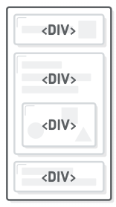
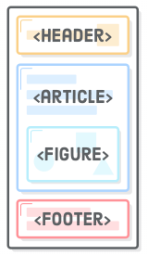
Semantic Markup
Ambiguous structure
Over the past decade, a strong and broad consensus has grown around the belief that HTML documents should only focus on the structure of the document.
Information about how the content should look when it is displayed in the browser is best left to CSS (Cascading Style Sheets).
Semantic HTML refers to the idea that all your HTML markup should convey the underlying meaning of your content—not its appearance.
Identifiable sections

Slide 5
Semantic Tags
Header – content at the top of web page
Footer – content at the bottom of web page
Article – a unit of web page content
Section – an arbitrary part of html content
Figure – container fo a graphic
Aside – a part of html content which amplifies something on the page

Slide 6
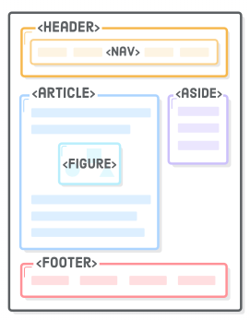
Page Structure Elements
HTML5 introduces several new page-structure elements that meaningfully identify areas of the page as headers, footers, articles, navigation areas, asides, figures and more.

Slide 7
Semantic Markup
As a consequence, beginning HTML authors are often counseled to create semantic HTML documents.
That is, an HTML document should not describe how to visually present content, but only describe its content’s structural semantics or meaning.

Slide 8
XHTML vs. HTML5
<body>
  <div id="header">
    <div id="navigation">
    </div>
  </div>
  <div id="article">
    <div id="section">
    </div>
    <div id="section">
    </div>
  </div>
</body>
<body>
  <header>
    <nav>
    </nav>
  </header>
  <article>
    <section>
    </section>
    <section>
    </section>
  </article>
</body>

Slide 9
<header>
<nav>
<article>
<section>
<aside>
<section>
<footer>

Slide 10
<header>
<nav>
<article>
<article>
<section>
<section>
<aside>
<section>
<section>
<footer>

Slide 11
<header>
<article>
<section>
<aside>
<nav>
<section>
<footer>

Slide 12
<article>
<header>
<nav>
<section>
<aside>
<section>
<article>
<article>
<footer>

Slide 13
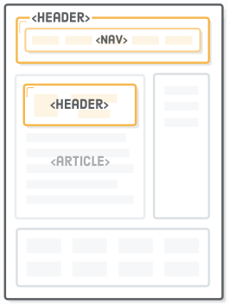
Header
Most web site pages have a recognizable header and footer section.
Typically the header contains
  the site logo
  title (and perhaps additional subtitles or taglines)
  horizontal navigation links, and
  perhaps one or two horizontal banners.
It denotes introductory content for a section, article, or entire web page.

Slide 14
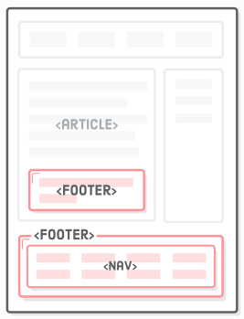
Footer
The typical footer contains less important material, such as:
  smaller text versions of the navigation,
  copyright notices,
  information about the site’s privacy policy, and
  perhaps twitter feeds or links to other social sites.

Slide 15
Header and Article
<header>
<img src="logo.gif" alt="logo" />
<h1>Fundamentals of Web Development</h1>
...
</header>
<article>
<h2>HTML5 Semantic Structure Elements </h2>
<p>By <em>Randy Connolly</em></p>
<p><time>September 30, 2012</time></p>
...
</article>

Slide 16
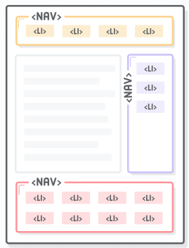
Navigation
The <nav> element lets you mark up the various navigation sections of your website. This goes for the main site navigation, links to related pages in a sidebar, tables of content, and pretty much any group of links.
<header>
<img src="logo.gif" alt="logo" />
<h1>Fundamentals of Web Development</h1>
<nav>
<ul>
<li><a href="index.html">Home</a></li>
<li><a href="about.html">About Us</a></li>
<li><a href="browse.html">Browse</a></li>
</ul>
</nav>
</header>

Slide 17
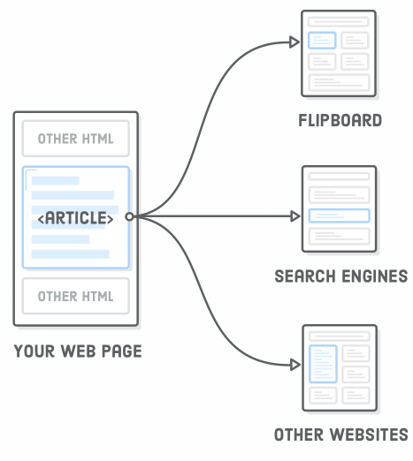
Articles
The <article> element represents some part of content that forms an independent component of a document or site; for example, a magazine or newspaper article, or a blog entry.
  An app like Flipboard should be able to grab an <article> element from your site, display it in its own app, and have it make perfect sense to its readers.

Slide 18
Sections
The <section> element represents some part of a document, typically with a title or heading.
The <section> element is sort of like an <article>, except it doesn’t need to make sense outside the context of the document.

Slide 19
<article> vs <section>
The article element represents a complete, or self-contained, composition in a document … and that is, in principal, interdependently distributable or re-usable.
The section element represents a generic section of a document or application …. The theme or each section should be identified, typically by including a section heading (h1-h6) as a child element of the section element.
  - W3C HTML5 Recommendation

Slide 20
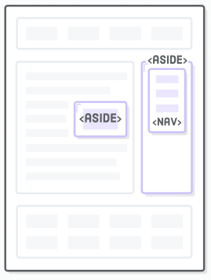
Aside
The <aside> element is used for marking up content that is separate from the main content on the page.
For example, a sponsored blog post might contain an advertisement about the sponsoring company; however, we probably don’t want to make it part of the article text. This is what the <aside> element is for.

Slide 21
Semantic Markup
Maintainability. Semantic markup is easier to update and change than web pages that contain a great deal of presentation markup.
Faster. Semantic web pages are typically quicker to author and faster to download.
Accessibility. Visiting a web page using voice reading software can be a very frustrating experience if the site does not use semantic markup.
Search engine optimization. Semantic markup provides better instructions for search engines: it tells them what things are important content on the site.

Slide 22
Any Question?

